Slide 1
You need more than science - Mentoring for all personality types
By Ruensern Tan and Brigette Monroy
Advising Graduate Students Conference

Slide 2
“You’ll be successful as long as you like the science”

Slide 3
Graduate school by the numbers
UC Davis has a 46.5% completion rate by the end of the 6th year
38.4% for Underrepresented minorities
This trend has persisted since the 1950’s
41% of PhD candidates experience anxiety, 39% for depression
6-times higher than the general population
40% of UC Davis graduate students with anxiety and/or depression do not cite “research responsibilities” as a source
UC Davis Graduate program data report 2017
Pain et al. Science 2018

Slide 4
The importance of a mentor-mentee relationship
1) Prior characteristics do not matter as much as development
2) Graduate student attrition is a function of … [the] structures and opportunities for integration.
3) The causes of attrition are deeply embedded in the organizational culture… and process of graduate education
The Mentor-Mentee relationship is a significant determinant of many success factors
Participation in institutional services (i.e. mental wellness classes, colloquiums, seminars)
Attrition
Learning experience
Lovitts 2001

Slide 5
Personal characteristics of a good mentor
Enthusiasm
Sensitivity
Recognizing individual differences
Respect
Unselfishness
Support
Lee et al. Nature 2007

Slide 6
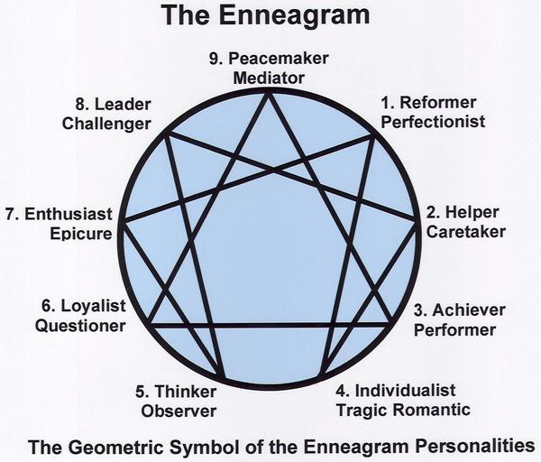
Enneagram of Personality
Model of the human psyche
Widely accepted in business management
9 personality types
All equally valid
One baseline-type but with “Bandwidth”
Science only appeals to one
“Flow”
Increased energy, happiness, and creativity

Slide 7
Test yourself!

Slide 8
Section 1
(A) I have tended to be fairly independent and assertive: I've felt that life works best when you meet it head-on. I set my own goals, get involved, and want to make things happen. I don't like sitting around -- I want to achieve something big and have an impact. I don't necessarily seek confrontations, but I don't let people push me around, either. Most of the time I know what I want, and I go for it. I tend to work hard and play hard.
(B) I have tended to be quiet and am used to being on my own. I usually don't draw much attention to myself socially, and it's generally unusual for me to assert myself all that forcefully. I don't feel comfortable taking the lead or being as competitive as others. Many would probably say that I'm something of a dreamer -- a lot of my excitement goes on in my imagination. I can quite content without feeling I have to be active all the time.
(C) I have tended to be extremely responsible and dedicated. I feel terrible if I don't keep my commitments and do what's expected of me. I want people to know that I'm there for them and that I'll do what I believe is best for them. I've often made great personal sacrifices for the sakes of others, whether they know it or not. I often don't take adequate care of myself --- I do the work that needs to be done and relax (and do what I really want) if there's time left.

Slide 9
Section 2
(X) I am a person who usually maintains a positive outlook and feels that things will work out for the best. I can usually find something to be enthusiastic about and different ways to occupy myself. I like being around people and helping others to be happy- I enjoy sharing my own well-being with them. (I don’t always feel great, but I try not to show it to anyone!) However, Staying positive sometimes meant that I’ve put off dealing with my own problems for too long.
(Y) I am a person who has strong feelings about things- most people can tell when I’m unhappy about something. I can be guarded with people, but I’m more sensitive than I let on. I want to know where I stand with others and who and what I can count on-it’s pretty clear to most people where they stand with me. When I’m upset about something, I want others to respond and to get as worked up as I am. I know the rules, but I don’t want people telling me what to do. I want to decide for myself.
(Z) I tend to be self-controlled and logical- I am uncomfortable dealing with feelings. I am efficient-even perfectionistic-and prefer working on my own. When there are problems or personal conflicts, I try not to bring my feelings into the situation. Some say I’m too cool and detached, but I don’t want my emotional reactions to distract me from what’s really important to me. I usually don’t show my reactions when others “get to me”.

Slide 10
Section 3
Code | Type | Type Name and Key Characteristics
AX | 7 | The Enthusiast: Upbeat, accomplished, impulsive
AY | 8 | The Challenger: Self-confident, decisive, domineering
AZ | 3 | The Achiever: Adaptable, ambitious, image-conscious
BX | 9 | The Peacemaker: Receptive, reassuring, complacent
BY | 4 | The Individualist: Intuitive, aesthetic, self-absorbed
BZ | 5 | The Investigator: Perceptive, innovative, detached
CX | 2 | The Helper: Caring, generous, possessive
CY | 6 | The Loyalist: Engaging, responsible, defensive
CZ | 1 | The Reformer: Rational, principled, self-controlled

Slide 11
How many “Investigators”?

Slide 12
Enneagram broken-down
Basic desires/fears
Sources of Validation
Connections
Temptations
Warning signs
Flow/Drag modifications
Integration/Disintegration

Slide 13
Successful implementation leads to improvements for workers, managers, and the organization
Greater interpersonal relationships
Reduced conflicts and miscommunication
Greater ownership
Improved responsibility taking behaviors
Greater institutional learning and development
Greater personal development

Slide 14
Tools to discover personality-type: Pivot points
Key points in people’s lives where their idea of “future self” changed
Changed careers, living arrangements, goals, etc.
Periods of personality growth
Questioning: What changed with your perception of yourself/others/the world before, during, and after the event?
Can be based on their enneagram number

Slide 15
Activity!
Share with a partner
“pivot point”
Talk about your latest career transition (i.e. postdoc to PI, grad school to postdoc, etc.)
Listener
Ask questions
Motivations
Changes in view of Self, Others, The World
Guess their number
Trade! (5-minutes per partner)

Slide 16
How did you do?

Slide 17
Case study #1
Student A – “I know what’s right.”
Student A is having a hard time completing a study. So far, the student has rejected all help saying, “If you want something done right, you have to do it yourself.”
Can you identify this student’s personality type?
How do you help Student A realize that it’s okay to seek out help from others?

Slide 18
Case study #2
Student A – “Conceptually this makes the most sense.”
Student B – “I’m not doing anything until we’re all on the same page.”
Student A and Student B are collaborating on a project. They both have the expertise that is necessary for this project to be completed and can’t be separated. However, the project has become stalled after many disagreements over the direction it should go.
Can you identify these students’ personality types?
How can you get these students to collaborate?
What should be avoided?

Slide 19
Case study #3
Student A – “I don’t care. It doesn’t matter to me.”
Student A was very motivated before QE’s. But soon after, you saw a drastic decline in their motivation. When talking to the student to see if everything is ok, they said “It’s fine”.
What is this student’s personality-type?
How do you get this student back on track?

Slide 20
Conclusion
There are multiple personality types in science that can be successful
Identifiable hallmarks of success and failures
Ask about “pivot points” to quickly determine personality types
If we appeal to our differences, the community benefits as a whole

