Slide 1
Promoting Student Wellness and Mental Health
Sharon L. Milgram, Director NIH OITE
www.training.nih.gov //Sharon.milgram@NIH.GOV
On Twitter @NIH_OITE // @SHARONMILGRAM

Slide 2
Three Goals
To help trainees appreciate the link between stress management/wellness and school/career/life success
To help trainees work through acute stressors with minimal disruption of their academic and research progress
To better support trainees with mental health concerns
Requires:
That we frame this as a wellness, not an illness, issue
Collaboration between PIs, trainees and institutional resource staff
Substantial personal and culture change

Slide 3
For Personal Change To Happen We Need To Ask…
Do I make it a priority to take care of myself?
Do I support others in taking care of themselves?
How much time do I spend time learning about wellness and resilience?
Do I reflect on my biases (conscious and unconscious) around mental health and wellness?
Am I willing to be vulnerable and share without making it about me?
Am I willing to use my institutionally-derived power and social capital to advocate for needed resources and for attention to wellness issues?

Slide 4
For Institutional Change To Happen We Need To…
Articulate a conceptual model of “wellness” grounded in the view that
“to do well, we have to be well”
taking time for wellness is our right AND an expectation that we have of our community
Develop programs to address all elements of your wellness model
Provide resources and reward PIs/programs that buy-in and promote the model

Slide 5
OITE Wellness Model
The things we do, and don’t do, to maintain our….
Body
Mind
Heart
Spirit
Wellness is a foundation of resilience.
Resilience is required for educational, science and career success

Slide 6
Resilience
The ability to navigate difficult situations with intention and ease; the ability to adapt and grow through adversity
To be resilient we need to:
Find community and engage authentically with peers and mentors
Use resources – proactively and in times of stress and setback
Find purpose day-to-day
Understand and acknowledge negative emotions
Have strategies for dealing with set-back and disappointments
Understand how distorted self-talk, cognitive distortions and imposter fears undermine our confidence and progress
Develop our growth mindset (the work of Carol Dweck)
Practice holistic self-care
Resilience = People + Process + Preparation

Slide 7
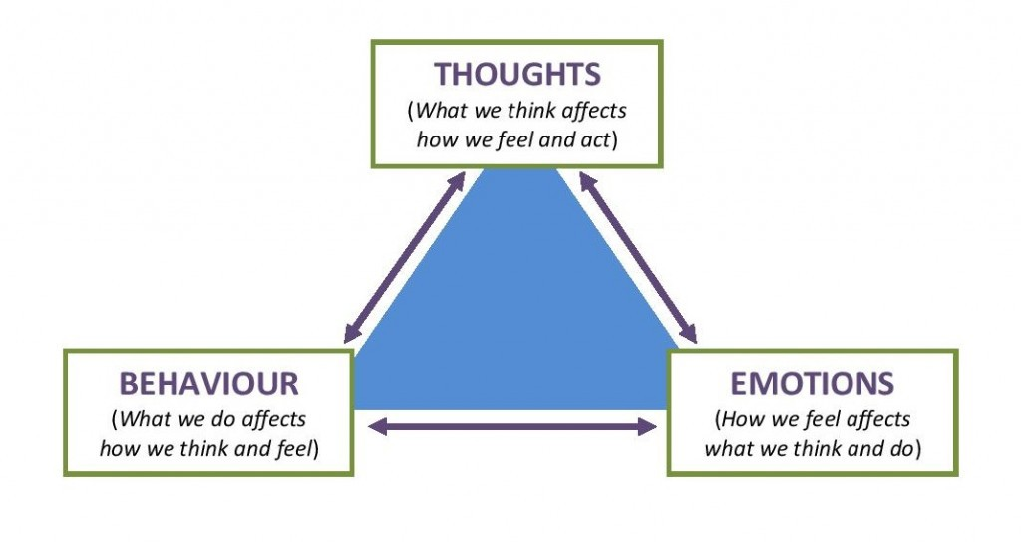
Three Loci of Control
https://beckinstitute.org/cognitive-model/
Notes:
One of the most highly researched ways of treating anxiety is CBT

Slide 8
Four Powerful Tools
Community
Journaling
Mindfulness
Support groups and therapy

Slide 9
Up-Coming Virtual Resilience Program for Your Students and Postdocs
Presentation via webinar, followed one week later by facilitated resilience groups discussions
An introduction to resilience and wellness
Understanding cognitive distortions and imposter fears
Emotions and the workplace
Self-advocacy and assertiveness
Developing feedback resilience
Managing up to maximize mentoring relationships
Starts September 15; information at www.training.nih.gov

Slide 10
Important Point About Research Groups
Organizational resilience = the way a team absorbs strain and…
continues to function effectively in the face of adversity
minimizes damage to team relationships for long-term effectiveness
A group is only as resilient as the individuals that make up that group AND resilience starts at the top

Slide 11
Key Take Home Message
TO DO WELL WE HAVE TO BE WELL

Slide 12
OITE Wellness Model
What we do and don’t do to maintain our….
Body
Mind
Heart
Spirit

Slide 13
Part A. OITE Holistic Wellness Assessment
So, how are you doing?
Never 1…………2…………3…………4…………5 Always

Slide 14
Wellness Assessment - Body
Never 1…………2…………3…………4…………5 Always
I am getting enough sleep (7-9 hours).
I am eating balanced, nutritious meals.
I avoid excessive use of caffeine.
I avoid excessive use of alcohol and other drugs of abuse.
I am getting regular exercise (at least 3 times a week).
I am getting regular health care for myself.
I take care of myself when I am sick, need rest, or just need a break.

Slide 15
Wellness Assessment - Mind
Never 1…………2…………3…………4…………5 Always
I avoid getting caught up in perfectionism.
I focus on the present vs. rehashing the past or worrying about the future.
I avoid negative or deceptive self-talk.
I practice self-affirmations and positive self-talk.
I avoid judging myself compared to others.
I give myself time to explore and learn about new things.
I am open to counseling as a tool to maintain and improve my health and wellbeing.

Slide 16
Wellness Assessment - Heart
Never 1…………2…………3…………4…………5 Always
I’m in touch with and let myself feel all my emotions.
I reach out to others for support when I need it.
I communicate my needs and feelings directly and honestly.
I make time to spend with my friends and ‘family’.
I engage in activities that are fun and relaxing.
I avoid extreme use of my phone as a coping tool/ avoidance strategy.
I demonstrate compassion for myself and others.

Slide 17
Wellness Assessment - Spirit
Never 1…………2…………3…………4…………5 Always
I feel connected to something that is bigger than me – however I define that.
I seek out resources (practices, activities, people, places) that nurture me spiritually.
I reflect on and invest in what is meaningful to me.
I read writings or watch media that are inspirational to me.
I think of and care about the lives of others who are different than me.
I allow time to just be (human being vs. human doing).
I engage in activities that support my life’s purpose.

Slide 18
For Later
As you went through the assessment questions did anything stand out for you?
What are you pleased about in your self-care practices?
What would you like to change?
What are barriers to making the changes you wish to make?

Slide 19
Self-Care Strategies
Learn to focus on breath
Maintain healthy behaviors, including
Healthy eating, adequate sleep, exercise and physical activity
Connect with the natural world, spend time outside
Connect with others, engage in healthy relationships
Avoid isolation, too much screen time and doom-scrolling
Seek help when needed, including professional help
Connect with yourself
Use supports such as journaling, mindfulness, meditation, yoga, therapy
Use wellness apps and other supports related to self-care such as: Insight Timer, Calm, Headspace, CBT-I Coach, Sleep Cycle
Practice gratitude, include things you are grateful for about you
Practice self-compassion – be a good friend to yourself
Keep on learning and growing
Relax, take breaks, have enjoyment

Slide 20
Building a Wellness Culture
Model wellness behaviors and priorities
Create a supportive circle of colleagues interested in wellness
Create and maintain good working relationships in your local wellness community
Encourage trainees, colleagues, staff to attend trainings on wellness and to engage in wellness practices
Highlight the relevant wellness implications in any discussions – including scientific, academic, career topics
Develop programs for faculty and staff
Include wellness in all mentoring conversations with trainees

Slide 21
The Wellness Collage
A way to identify and talk about things that bring happiness and meaning to our lives
KEY TAKE-AWAY: Never under-estimate the things in your life that bring you happiness and meaning

Slide 22
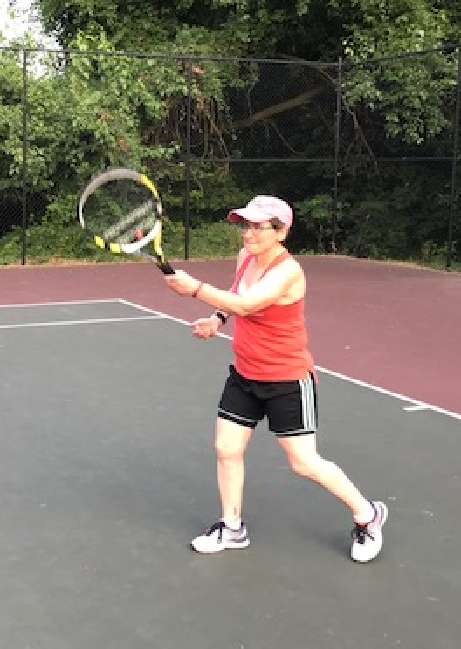
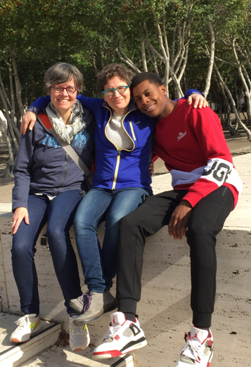
@nih_oite, #OITEwellnesschallenge

Slide 23
A Helpful Hack
Cannot
Control
Wish to
Control
Can
Control

Slide 24
And Some Resourcces
www.youtube.com/channel/UCQQHo_QnuBxdfcsRy4INGGw

Slide 25
