Slide 1
Demystifying Complex International Student Issues
Sharon Ericsson, SISS International Student Advisor
Matthew Kaminski-Lucas, SISS International Student Advisor
Robert Nagel, SISS International Student Advisor
Tammy Silver, Assistant Director, International Students Services

Slide 2
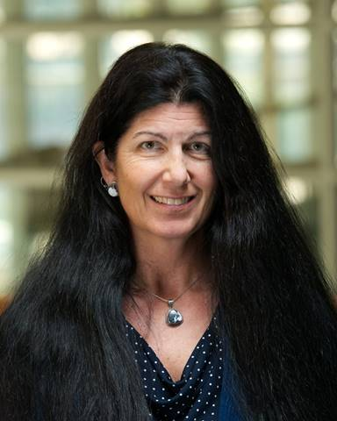
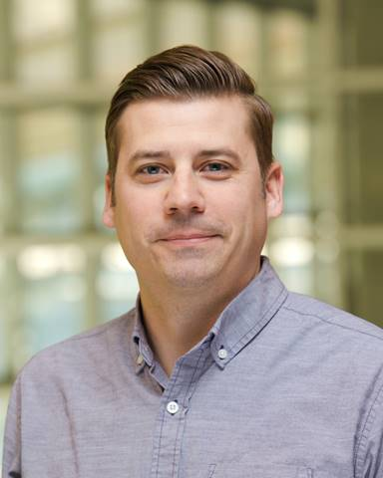
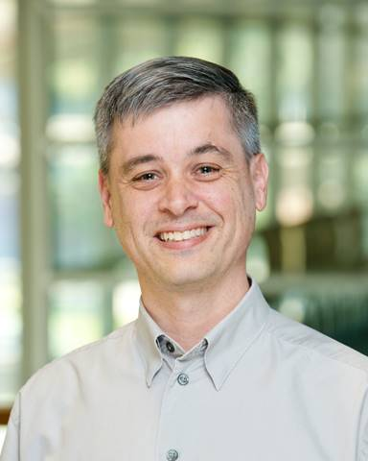
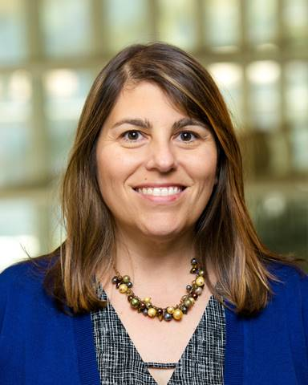
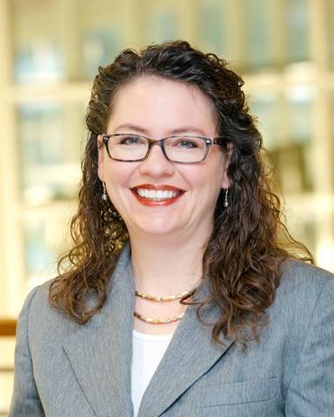
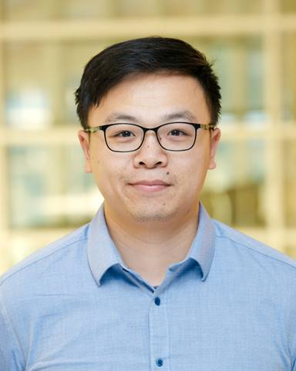
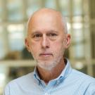
Panel & Table Moderators (https://siss.ucdavis.edu/people)
Tammy Silver,
Assistant Director,
International Student Services
Matt Kaminski-Lucas, International Student Advisor
Robert Nagel, International Student Advisor
Sharon Ericsson,
International Student Advisor
Robb Davis,
Director of Intercultural Programs
Emily Taylor, International Student Advisor
Kai Cheng,
International Student Advisor
Kai Cheng,
International Student Advisor
Sharon Ericsson,
International Student Advisor
Notes:
Introduce team
Get a sense of who’s in the room-poll audience, faculty advisor, Grad coord.
Point out website
Pull up website
Show where to find advisor of alpha
TELL THEM ALPHA IS CHANGING SOON

Slide 3
Agenda
SISS Federal Reporting Requirements
Enrollment Issues
Unsatisfactory Progress
Under-enrollment
Lack of funding
In Absentia
PELP
Employment
On-campus
CPT
Tablework - Case Studies
Wrap Up

Slide 4
Assumptions about Participants
Basic understanding of enrollment and employment requirements for F & J international students
List of acronyms and definitions for those not as familiar with terminology on tables
Notes:
Tell them this is intermediate/advanced
Have them look at packet they picked up at entrance
Brief description of J and F categories.

Slide 5
Achievement Based Objectives
Distinguish key SISS termination deadlines that would inform your approach to supporting international students
Identify your "go – to" person in SISS when you have a time sensitive issue, question or concern regarding an international student
Analyze typical student cases that could lead to visa status problems and formulate approaches for dealing with them
Notes:
This is what you will have done in this room by the end of this session

Slide 6
SISS Federal Reporting Requirements

Slide 7
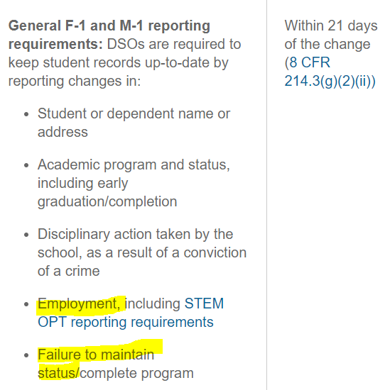
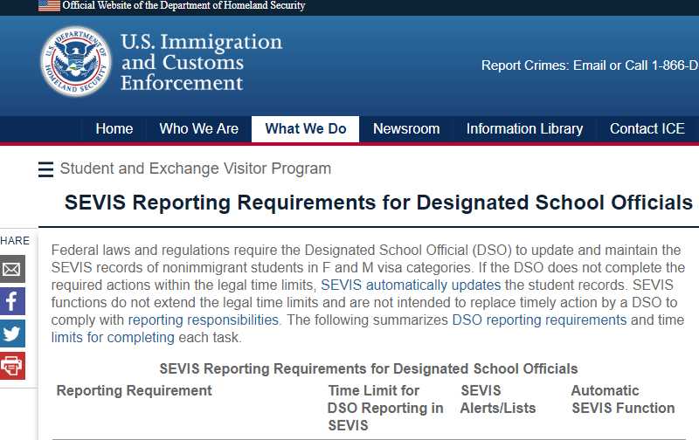
SISS Department of Homeland Security mandate
Notes:
SEVIS is the Student and Exchange Visitor Information System, which is a real time interactive database. Read first sentence up to “nonimmigrant students”. Explain that we are all DSOs (except Robb) for SEVIS recordkeeping and reporting. Highlight the 21 day reporting deadline that is part of the Federal Code of Regulations and how this deadline is important to our collaboration regarding international students maintenance of status

Slide 8
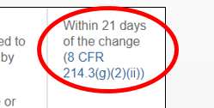
So what does the 21 day deadline mean?
Within 21 days of the student not maintaining status SISS must:
Terminate the SEVIS record/I-20 (termination equals departing the United States)
Shorten the SEVIS record/DS-2019 (shortening equals departing the United States)

Slide 9
Two Key Status Issues
E²
Enrollment
Employment

Slide 10
Enrollment
Unsatisfactory Progress
Under-enrollment
Lack of funding
In Absentia
PELP

Slide 11
Unsatisfactory Progress
Academic status | Immigration status impact
Unsatisfactory progress assessment | None
Academic probation/not good academic standing | None if no registration hold
Academic probation resulting in a registration hold | May result in termination/shortening of SEVIS record/I-20 or DS-2019*
*In extremely rare cases, a student may be able to transfer
Notes:
The possibility of an international student's SEVIS record/I-20 termination to influence academic decisions
Unsatisfactory Progress = opportunity to improve

Slide 12
Under-enrollment
Less than 12 units by the 21 day deadline
Results in termination for under-enrollment
Students receive weekly auto emails from the first day of the term

Slide 13
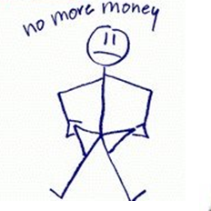
Lack of Department Funding
Notes:
Dropped for non-payment
Not enrolled = out-of-status

Slide 14
In-Absentia
Students are registered in 12 units, just forward the form to SISS for a signature.
Notes:
For immigration purposes we will always approve so long as Graduate Studies has approved. We sign last. SISS will need to report J’s location change.

Slide 15
Report changes to (R)
Address
Name
Major
Nationality
Academic objective
Marital status
Funding source
Dependents
Check-in upon arrival
Pursue full time course of study (E)
Obtain travel endorsement before leaving US
Leave US (or transfer record) in timely way after completion/disqualification/withdrawal (E)
Make normal academic progress
Work only with authorization and report post completion employment (E)
Theme: International students who are not registered may experience a problem

Slide 16
Handling Enrollment Situations
Outreach
Early Intervention
Employ flexibility within the Federal Regulations
Notes:
An SISS International Student Advisor may reach out to a Graduate Coordinator regarding an unresponsive student
… A graduate coordinator has confirmed in an email prior to the 21 day deadline that the student is working on meeting graduate program requirements and will be registered for the term in question.
Ensures consistency and transparency

Slide 17
Questions to ask yourself
Can the international student register in 12 units?
Is the student a non-responder?
Yes
No
Yes
No
No under-enrollment immigration status issues
SISS can help determine if the student is in the United States & can help try to contact
Have we reached out to SISS about this student?
Yes
No
SISS wants to work with you to make a plan for students facing academic difficulty

Slide 18
Brief activity
Turn to the person next to you and exchange how you might use the information up to this point while interacting with an international student.

Slide 19
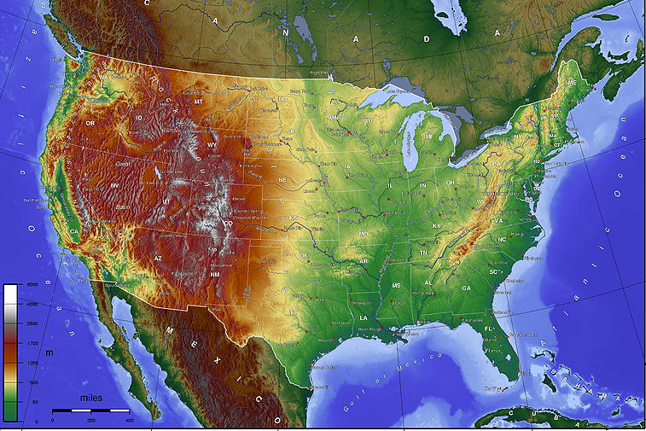
PELP
PELP/Withdrawals= NOT in U.S.
(Except for Medical Reasons)
Impact of leaving UC Davis
If new I-20/DS-2019
Additional fees
Work eligibility clock starts again (F-1)
Notes:
If PELP for more than one term

Slide 20
Medical PELP requires RCL (reduced course load)
F-1: Approval through SISS that is reflected on the I-20 to drop below 12 units
J-1: Approval noted on record but not DS-2019
May not exceed an aggregate of 12 months while the student is pursuing a course of study at a particular program level
UC Davis Requirements
SISS Requirements
Notes:
Talk about two tracks: One is the track the student must adhere to in order to meet University requirements and the other is the track the student must adhere to in order to meet immigration compliance.

Slide 21
SISS Requirements for Medical RCL (Reduced Course Load)
Can occur any time during term
If a non-UC Davis practitioner, SISS advisors will confirm validity of signatory
If a valid yet unauthorized signatory, SISS advisors will work with signatory to get valid co-signatory
Notes:
Review handout

Slide 22
Questions to ask yourself – F-1
When are they resuming studies?
How does this impact on-campus employment?
Refer to SISS or coordinate holistic care approach with SISS?
Notes:
When are they leaving?
When are they returning?
How does this impact on campus employment?
Refer to SISS or coordinate communication with SISS

Slide 23
Questions to ask yourself – J-1
Serious illness, injury or incident (hospitalization)?
Death?
Must be reported to SISS
Notes:
DosHS and DoS mandate. Any incident we have a requirement to report that incident to the DoS. Any info on student in J status needs to be passed on to us.

Slide 24
Work Authorization

Slide 25
Work Authorization Basics
F-1 students may work on-campus without work authorization
J-1 students must have on-campus work authorization
CPT (curricular practical training) and OPT (optional practical training) require work authorization

Slide 26
Work Authorization Intermediate
Lawrence Livermore and Berkeley labs are considered on-campus
Requires a letter from SISS
West Village Apartments is considered on-campus
Employment at Cal Fresh outside of UC Davis (Department of Agriculture and Environmental Sciences) is not considered on-campus
If you are unsure, ask an SISS international student advisor as there are regulatory guidelines guiding when an off-campus location in is treated as on-campus
Notes:
These are examples only to demonstrate the complexity surrounding on-campus employment

Slide 27
Work Authorization Advanced
What international students do now may have an impact on them later
USCIS is applying the strictest interpretation of the law
Full-time CPT may (wrongly) influence decisions about OPT
H1B applications are receiving a high level of scrutiny, in some cases down to on-campus employment and all CPT
SISS’ position is to help students maintain status to preserve eligibility for all higher level benefits
Notes:
Third bullet: FT CPT applying toward OPT and cutting months short

Slide 28
Graduate Student Curricular Practical Training (CPT) Authorization Policy
For Work During Fall, Spring, or Winter Quarters
Student Has Advanced to Candidacy
Yes
No
Student is on Filing Fee
The Student is in Paid Employment on Campus in ANY Capacity
No
Yes
The Student is in Paid Employment on Campus in ANY Capacity
Yes
No
No
Yes
Working 20 hours per week
Working <20 hours per week
>20 hours per week requested for CPT AND needed to complete dissertation
≤20 hours per week requested for CPT
>20 hours per week requested for CPT AND needed to complete dissertation
≤20 hours per week requested for CPT
No CPT Authorization
Can be authorized for CPT up to 20 total hours per week on- AND off-campus
Can be authorized for CPT up to 20 hours per week
No CPT Authorization
Can be authorized for CPT with evidence of need for FULL TIME work to complete dissertation
Can be authorized for CPT with evidence of need for FULL TIME work to complete dissertation
Can be authorized for CPT up to 20 total hours per week on- AND off-campus OR authorized for >20 hours per week with evidence of need to work to complete dissertation
Can be authorized for CPT up to 20 hours per week
Notes:
FT = 20 hours/week

Slide 29
Questions to ask yourself
The student working on campus? How might this impact additional work authorizations?
Has the student advanced to candidacy?
If the student is requesting full-time employment, why is it necessary for the student to be employed full-time rather than part-time in order to meet graduation requirements?

Slide 30
Case Studies
Review case with your table (SISS facilitator can read to the group)
Discuss your options in advising the student (take timing into consideration)
Consider if, when, and how you may engage SISS
Who would you contact at SISS?
Tell each other at your table how this may change your advising
Notes:
2:30 Matt with all to facilitate

Slide 31
SISS Philosophy
We want to be your campus partner to assist in student success = Outreach
We believe in early interventions are in students' best interest = Options
Our goal is to best position international students to access higher-level benefits and opportunities once they leave UC Davis = Long term
Notes:
2:50
Not punitive, have the best opportunities when they leave.
In closing

Slide 32
How Can SISS Help You?
Publish our termination deadlines & work authorization workshop dates to the graduate coordinator list serve prior to the beginning of each term
Organize quarterly meetings to address specific issues or answer questions
Come to you, your offices, meet with you and groups of students who have questions
Questions or suggestions? Email: siss@ucdavis.edu Subject: AGS
Notes:
These are only three that we came up with. What else would you suggest?

Slide 33
Notes:
Questions

