Slide 1
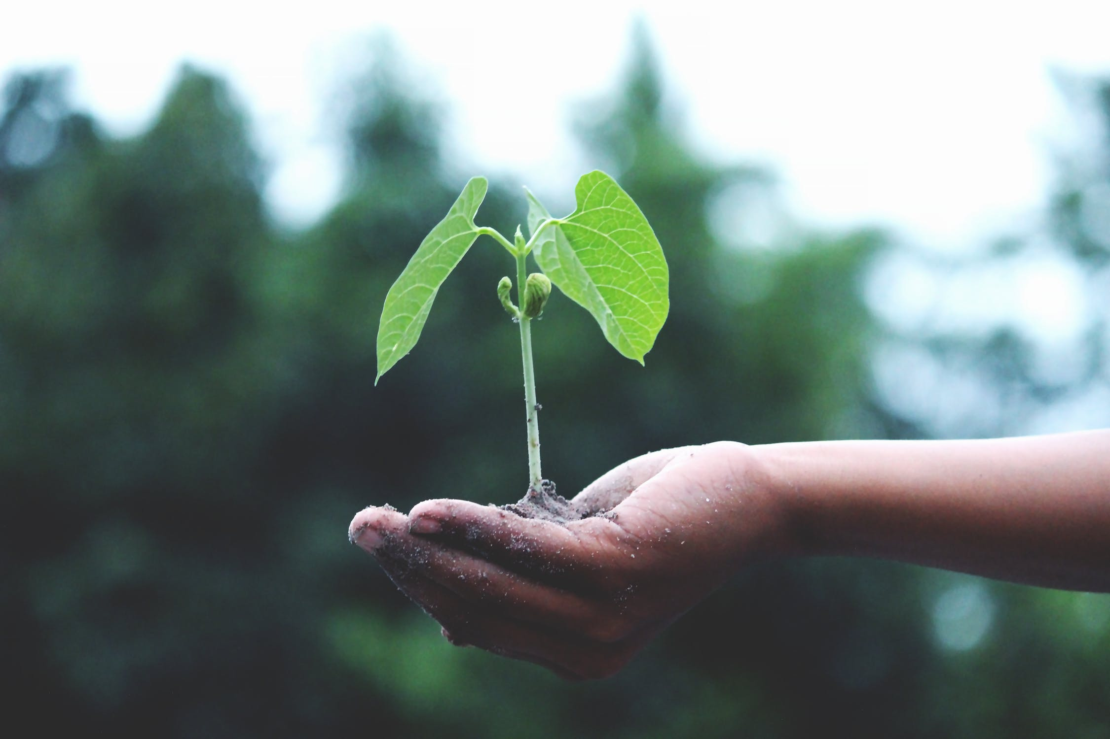
All Aboard the Mentorship
Making and using an Individual Development Plan for graduate education
Our students, growing scientists, who need an IDP.
Notes:
(both)

Slide 2
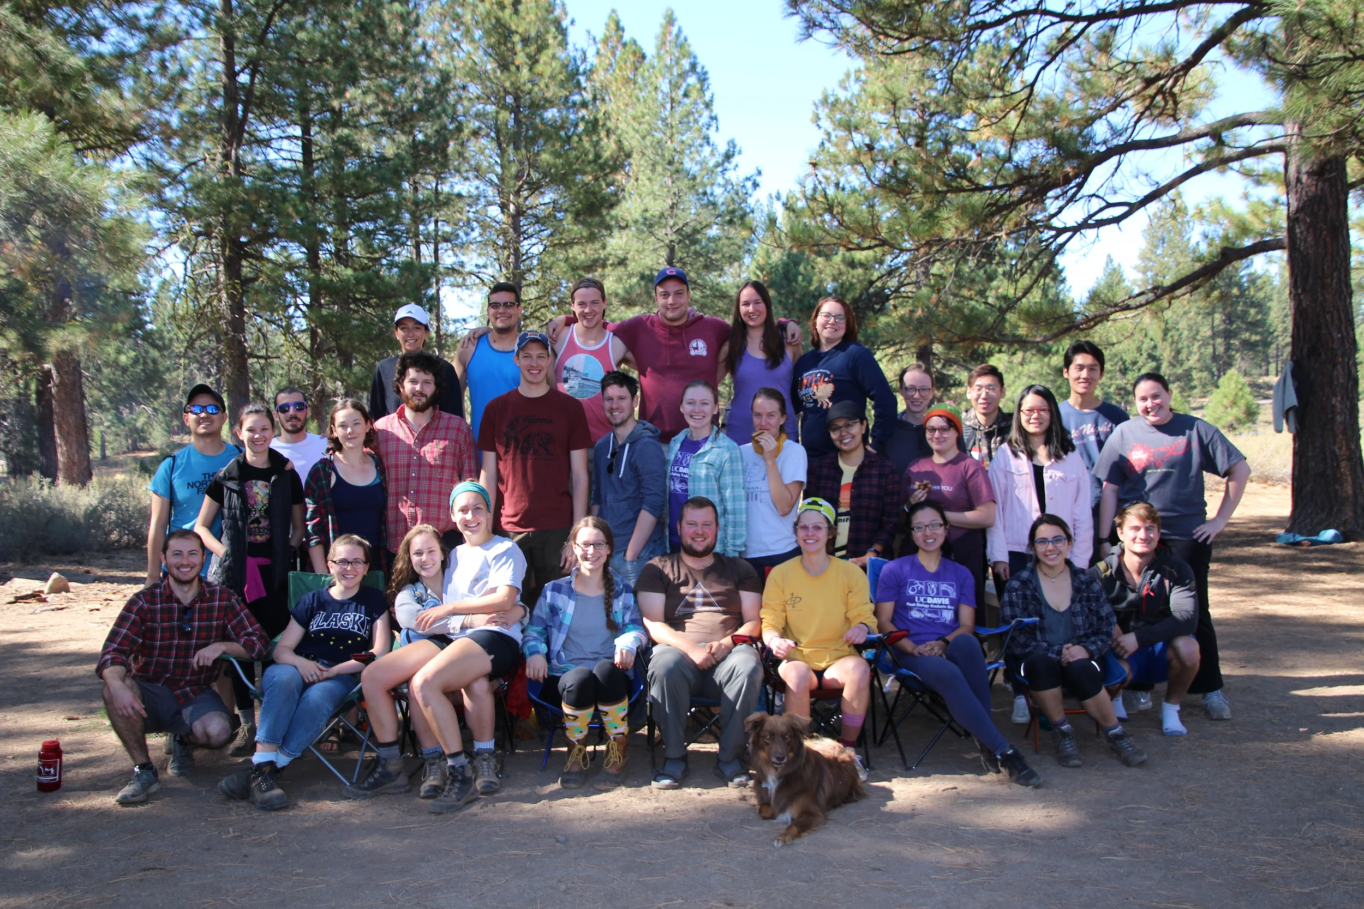
Notes:
Laura
Discuss the reasons why IDPs entered the collective graduate group conscious in ~2017
-- 2015 annual graduate group meeting highlighted tensions between students and faculty, students felt they weren’t getting enough help
-- 2017 program review reiterated the same issues

Slide 3
What are the expectations of a PhD graduate?
Notes:
Laura

Slide 4
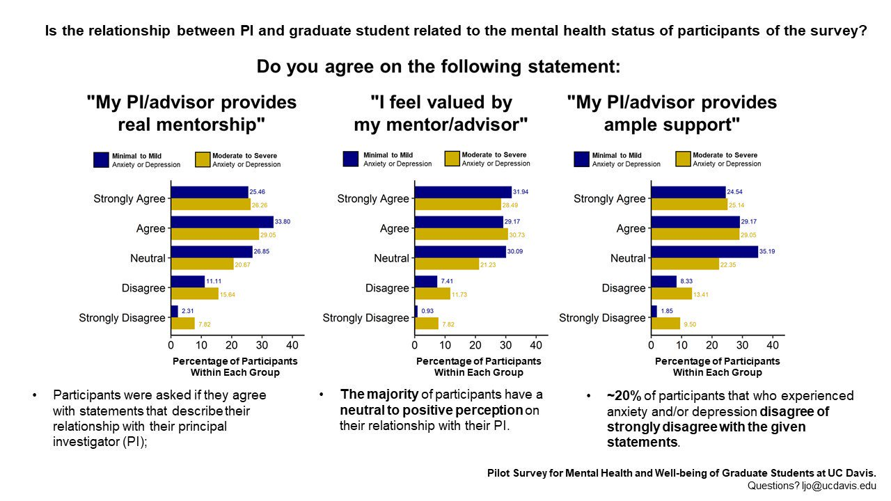
Notes:
Laura

Slide 5
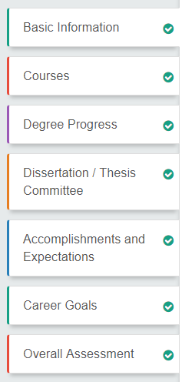
UC Davis Student Progress Assessment
Implemented in Spring 2018
Does discuss accomplishments and goals
Sent to Graduate Studies
Notes:
Laura

Slide 6
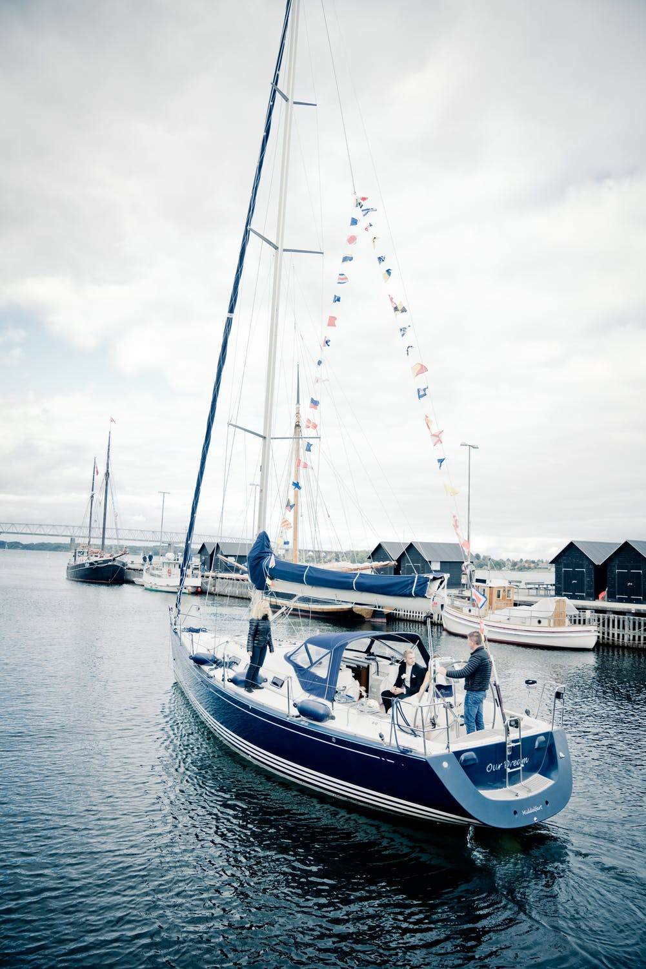
Our solution: An individual development plan (IDP)
I thought you were steering!
I thought you were steering!
Mentor-SHIP
Notes:
Katie

Slide 7
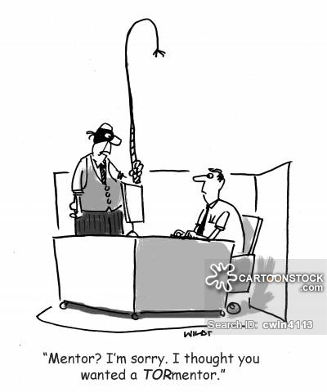
What is an IDP?
Career development tool
Evaluate current strengths and weaknesses
Set goals based on the evaluation
Make a plan to achieve those goals
Personal reflection and a conversation with the trainer
Notes:
Katie

Slide 8
IDP Benefits
In a 2005 survey of US postdoctoral scholars, IDPs helped postdocs
● Manage time and resources
● Submit first-authored papers to peer-reviewed journals
● Submit grant proposals
● Cultivate a productive relationship with advisor
Notes:
Katie
In a 2005 survey of US postdoctoral scholars, IDPs helped postdocs
● Able to develop better time management, more efficient resource use, and more focused effort than their peers without an IDP
● 23% more likely to submit papers to peer-reviewed journals
● Publish first-authored papers at a 30% higher rate
● Submit grant proposals at a 25% higher rate
● 25% less likely to report that their advisor did not meet their initial expectations
Submit papers == 23% more likely
First author == 30% higher rate
Submit grants == 25% higher
Advisor expectations == 25% less likely

Slide 9
How we made an IDP
Spring 2016
Spring 2017
Spring 2018
Winter 2019
Spring 2019
Future
Revision
Mandatory requirement
Revision w/ Mentoring Committee
18 students
Decision to make an IDP
Research and writing
First test (us!)
Notes:
Both of us
Initial annual meeting where Julin had the idea.
Massive Google search/IDP congomeration → first draft IDP
First round of student testing -- we are the guinea pigs
Revision with mentoring committe/seeking faculty approval + Exec Committee okaying everything
Training students + a few PIs how to use
Grad group wise (non-mandatory) testing
Feedback
FUTURE: mandatory implementation after further revision
1-4: Laura
5-8: Katie

Slide 10
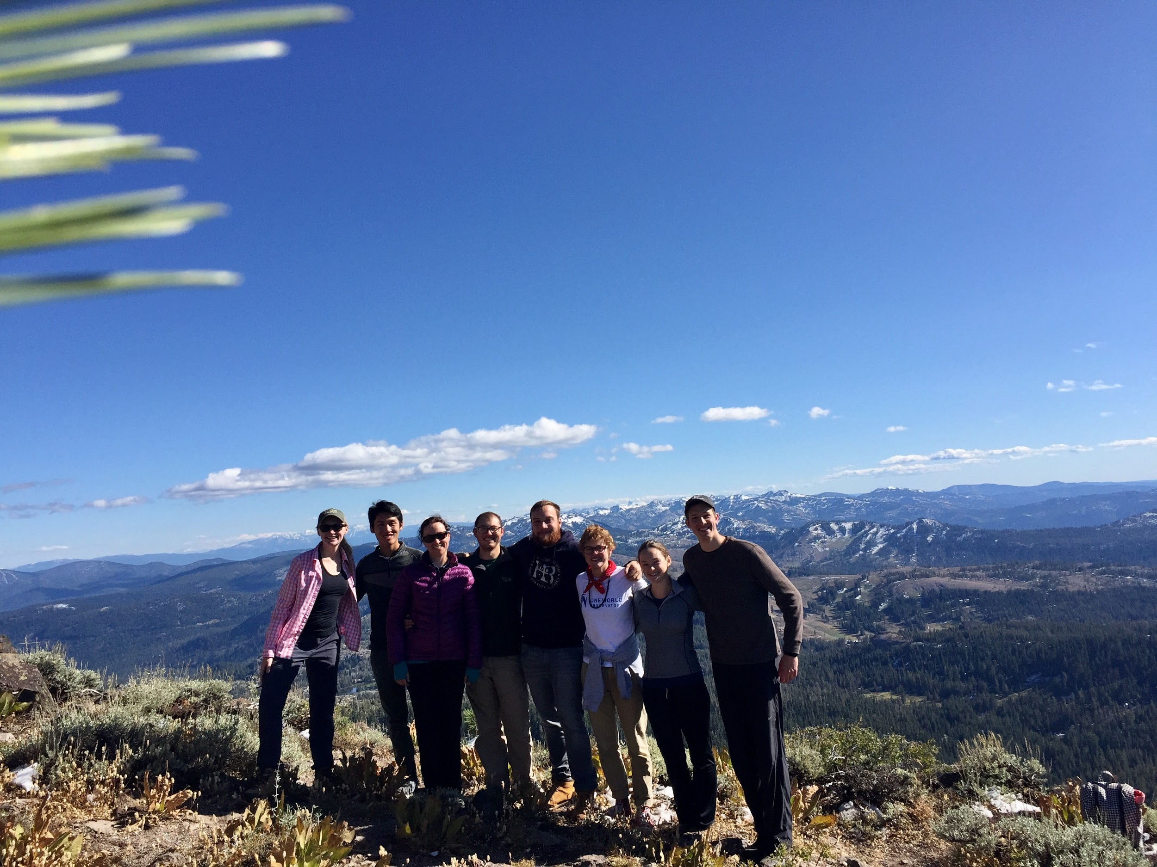
Part 3: Where you came from
Part 4: Where you’re going
Part 1 and 2: Where you are
Notes:
Katie if she finds the picture

Slide 11
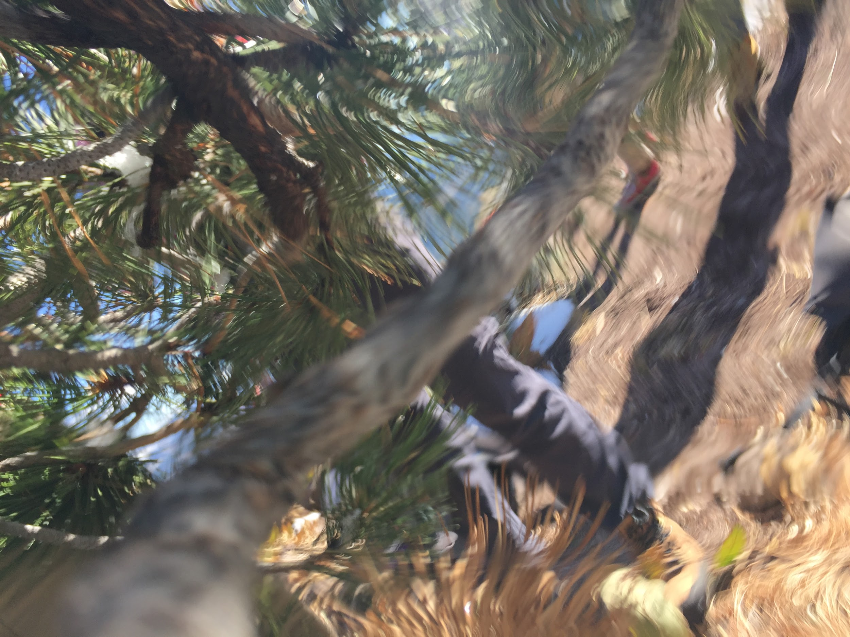
Part 3: Where you came from
Part 4: Where you’re going
Part 1 and 2: Where you are
Notes:
Katie if she finds the picture

Slide 12
Follow along with the document: www.shorturl.at/aimS6
Mentor-SHIP

Slide 13
Part 1: Who are you, and who are your mentors?
Follow along with the document: www.shorturl.at/aimS6
Notes:
Laura

Slide 14
Section 2: Self Evaluation and Trainer Evaluation
Student rates themself on qualities and knowledge that you should have by the end of graduate school
When completed, the advisor will review it and rate the student using the same evaluation form
Estimate how much time the student spends on certain skills/knowledge so they can better allocate their time next year
% time this year __________% time next year__________
Notes:
Katie

Slide 15
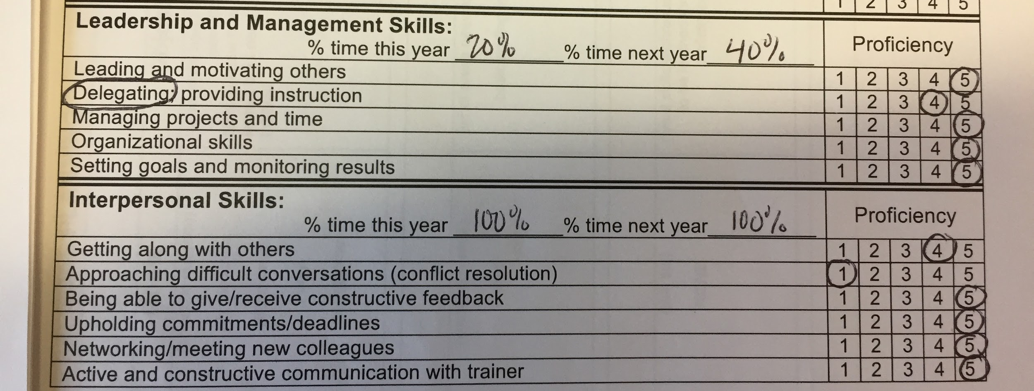
Katie’s self evaluation
Katie’s advisor
Notes:
Katie

Slide 16
Section 3: Looking Back
wrote blog post
technique learned
troubleshooting
outreach
conferences
Notes:
Laura
What are the projects the student accomplished last year?
Describe and explain the student’s level of satisfaction with their research project in the past year.
Describe and explain the student’s level of satisfaction with other aspects of their career development in the past year
In future years, they will look at the old IDP and determine if you achieved goals you set
Knowing how the student did last year will help the student plan for the future

Slide 17
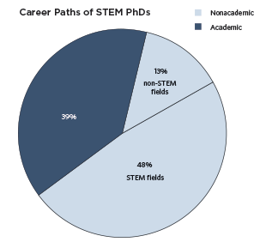
Section 4: Looking really forward
Diverse career paths after PhD
Finding resources requires proactive approach
Graph taken from: https://www.the-scientist.com/careers/addressing-biomedical-sciences-phd-problem-32258
Notes:
Laura
Our students felt unprepared for life after graduate school.
Some students had never talked to their advisors about their career goals!
There is still a stigma around careers that are not academic.
There are lots of opportunities for professional development on campus - but a student must be proactive to find and participate in those.

Slide 18
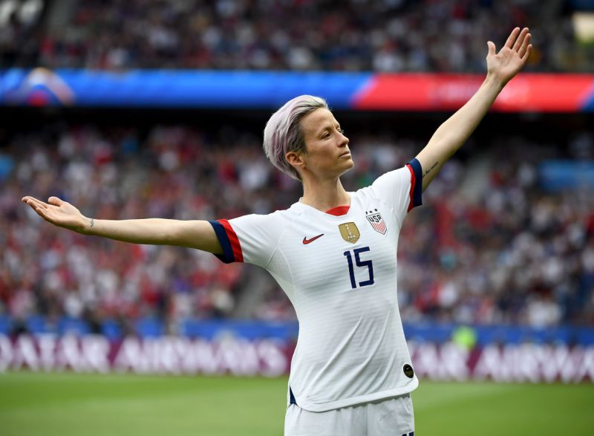
Section 5: Goal planning (looking forward)
Research Project
Goals | Objectives | Actions and Strategies | Timeline | Outcomes
(scientific question) | (what skills need to be learned or developed) | (experimental approach) | (anticipated start and end times) | (how you will know you have reached your goal)
Notes:
Katie

Slide 19
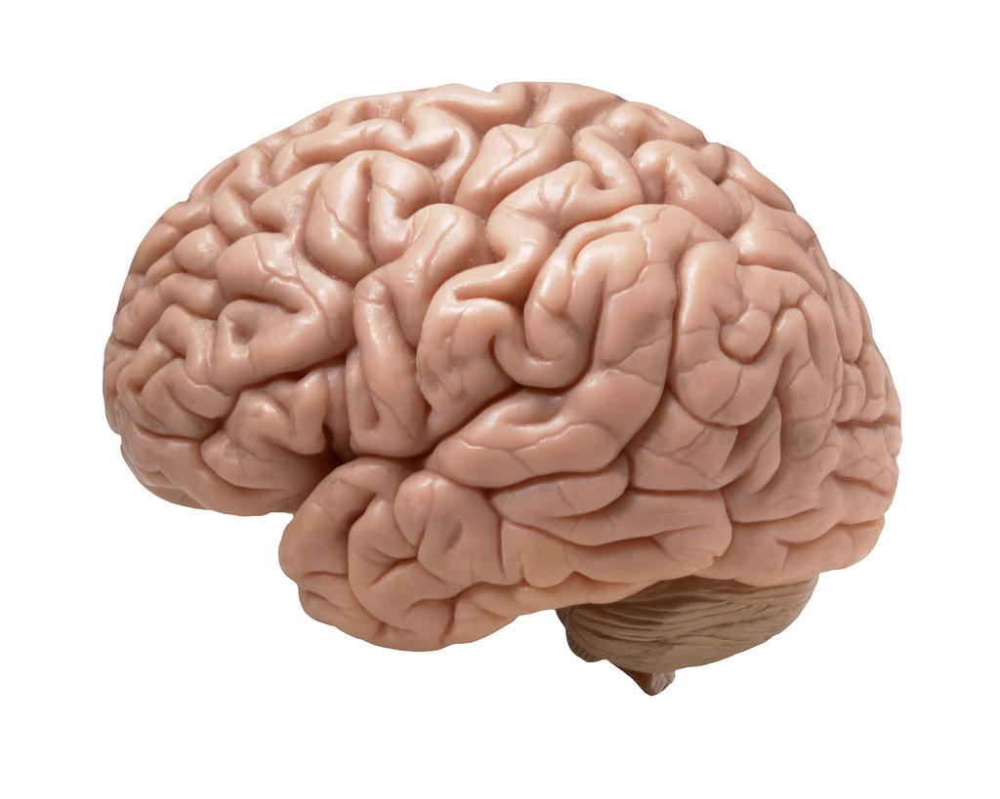
Make your goals SMART
Example: I want to learn about my career options!
Not SMART | SMART
I will learn about my career options. | I will learn about careers in agricultural biotechnology by conducting informational interviews with 3 professionals by the end of September.
Specific
Measurable
Attainable
Relevant
Time-bound
Notes:
Katie

Slide 20
Section 6: Funding
This is required for the UC Davis Plant Biology graduate group.
This should facilitate a discussion with the advisor in regards to fellowships, TA requirements, etc.
Notes:
Laura

Slide 21
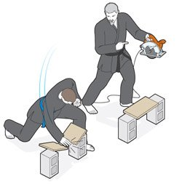
Section 7: Meeting
An IDP doesn’t cure a bad advisor-advisee relationship
It can help facilitate important discussions that aren’t happening otherwise.
Notes:
Katie

Slide 22
“But the faculty will think this is extra paperwork…”
We tell our students to respond with….
I would really like your advice on...
This document is really helping me plan experiments. Can I get your insight?
This is soon to be a requirement.
This is useful for writing the training section of grants.
Notes:
Laura

Slide 23
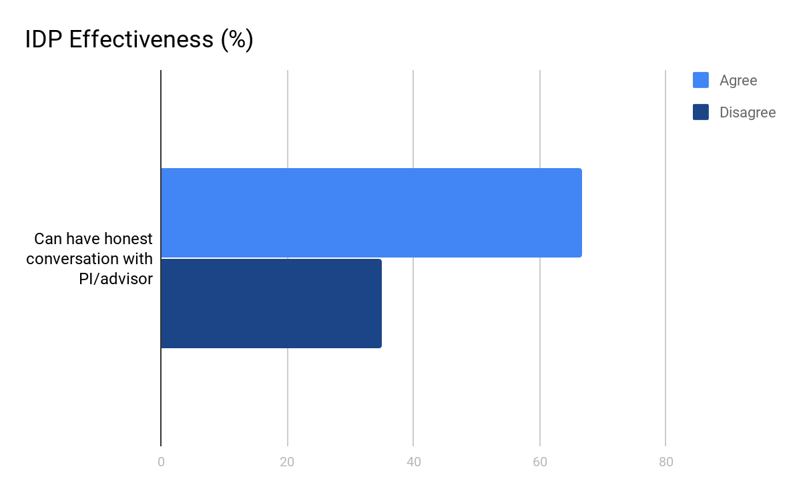
Does an IDP really help students?
Vanderford et al (2018)
Surveyed ~650 graduate students
66.7%
34.9%
Notes:
Laura

Slide 24
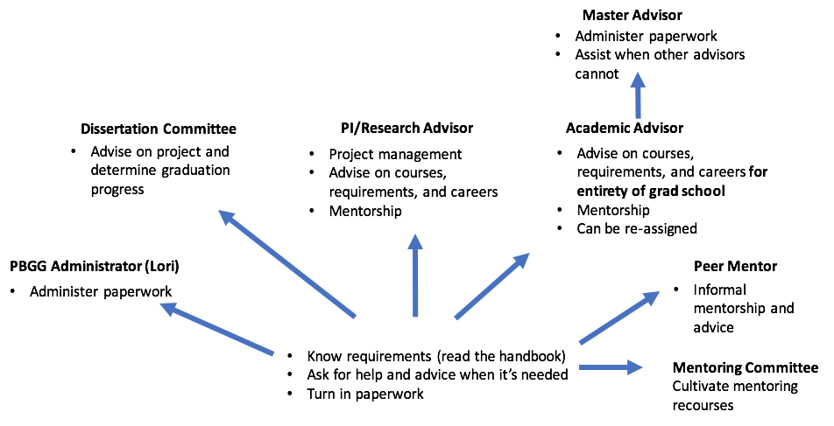
Graduate Advising in PBGG
Notes:
Laura

Slide 25
Feedback from first IDP - 18 students
“I think it started really good conversations and was a good platform to do it.”
“I liked that it made me really address what I wanted and what areas I need to improve.”
“Nice to be forced to think about concrete goals and timelines; difficult but that also means this form is useful bc it's something I may not have done otherwise.”
To improve: Redundancy in the form, clarification in some instructions
Notes:
Katie

Slide 26
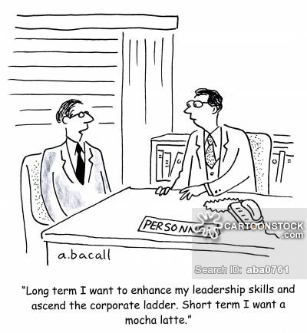
Conclusions
IDPs are a tool to help students:
Have difficult conversations
Clarify expectations
Reflect on the past
Plan for the future
Graduate!
Notes:
Laura

Slide 27
Acknowledgements
The Plant Biology Graduate Group
Lori Bergum
Julin Maloof
Georgia Drakakaki & the mentoring committee
Dan Kliebenstein
Leonardo Jo
ALL our peers!
Laura Klasek: lkklasek@ucdavis.edu
Katie Murphy: kmmurphy@ucdavis.edu
All
aboard!!
Mentor-SHIP
Notes:
Laura

Slide 28
More from Leonardo’s survey that might be useful

