Slide 1
University of California, Davis
Academic Advising Mentoring Program
Prepared by the 2019 AAMP COMMITTEE
Notes:
Rachel D.

Slide 2
MAIN TOPICS
Reflection
Introduction to AAMP
Mentor & Mentee Pairing
Application Process & Timeline
Calendar of Events
Q&A
Table of Contents
Notes:
Rachel D

Slide 3
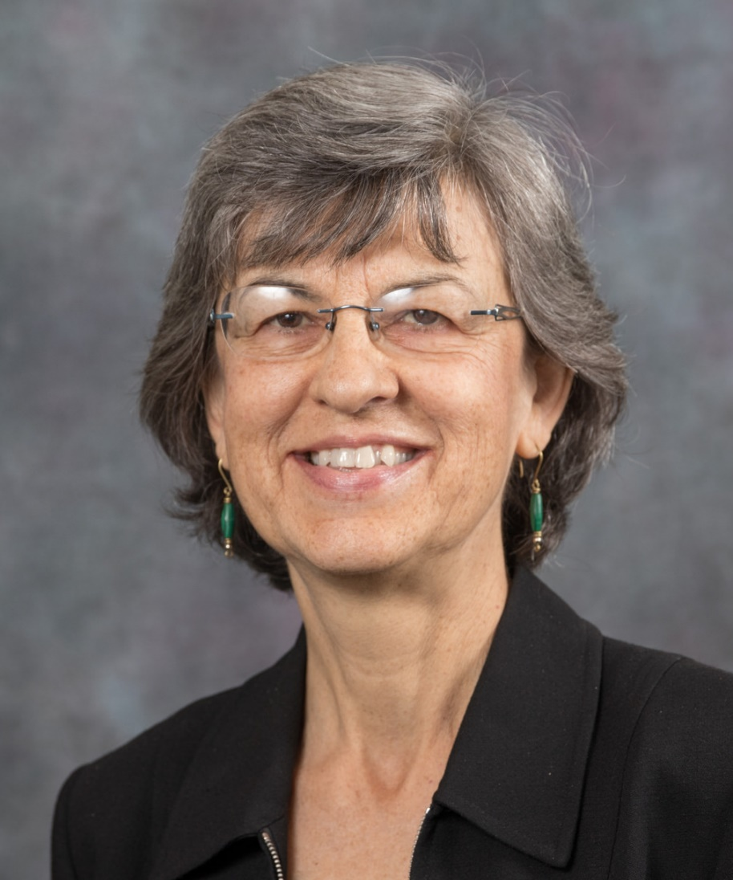
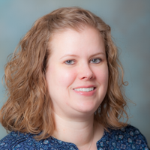
Today's
Presenters
RACHEL
DE LOS REYES
RACHEL HALE
NANCY DAVIS
Notes:
Rachel D.

Slide 4
An investment in knowledge pays the best interest.
- BENJAMIN FRANKLIN
PROFESSIONAL DEVELOPMENT:
A WORTHY INVESTMENT

Slide 5
Reflection
ACTIVITY
Reflect on your own professional development, experience with informal/formal mentoring, and wishes for professional development.
Notes:
Rachel H.

Slide 6
What is AAMP?
Notes:
Nancy

Slide 7
ENHANCE ADVISING
MENTORSHIP
Use experience and leadership skills to enhance advising and career development.
The program matches advisors with more seasoned advisors.
CONNECTIONS
CAREER GUIDANCE
The program serves to create connections for advisors to broaden their advising network and enhance engagement.
Mentors will help mentees identify short and long term career goals and provide tailored support to personalize the mentoring program for each individual.
Notes:
Nancy

Slide 8
HISTORY OF AAMP
Founding Year
AAMP rolls out
Changes to program
AY 2015-16
What has changed as the program has grown?
AY 2014-15
Notes:
Nancy
2014-15 – ATPD created; spent the year creating the structure of AAMP
2015-16 – 1st cohort; only one large group meeting – group requested more
2016-17 – quarterly events
2017-19 – social events each quarter
2019-20 – adding “Lunch & Learn” events
Always looking for ways to keep alums connected

Slide 9
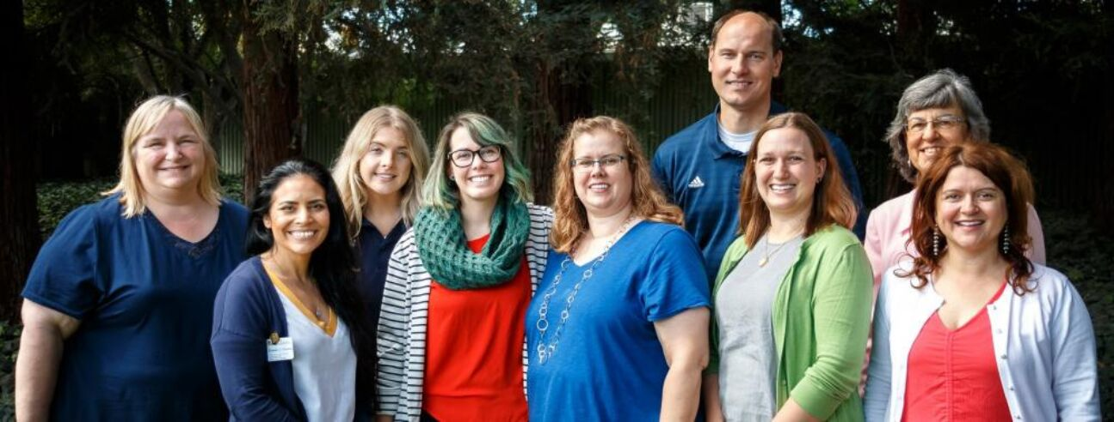
AAMP Subcommittee
Notes:
Rachel H.

Slide 10
Mentor & Mentee Pairing
Notes:
Rachel H.

Slide 11
Support
Mentor Roles
Introduction to campus resources
Answer questions, be available
Notes:
Rachel H

Slide 12
Ask questions
Mentee Roles
Be engaged
Be open to learning
Notes:
Rachel H

Slide 13
ATTEND BROWN BAG/ INFO SESSION
DISCUSS WITH YOUR SUPERVISOR
How to Apply
FILL OUT APPLICATION
Notes:
Rachel D.

Slide 14
Application available Spring Quarter
Acceptance Emails sent late June
TIMELINE
Kickoff Event with Pairing Announcement early September
Notes:
Rachel D.

Slide 15
Mentor & Mentee Expectations
Notes:
Rachel D.

Slide 16
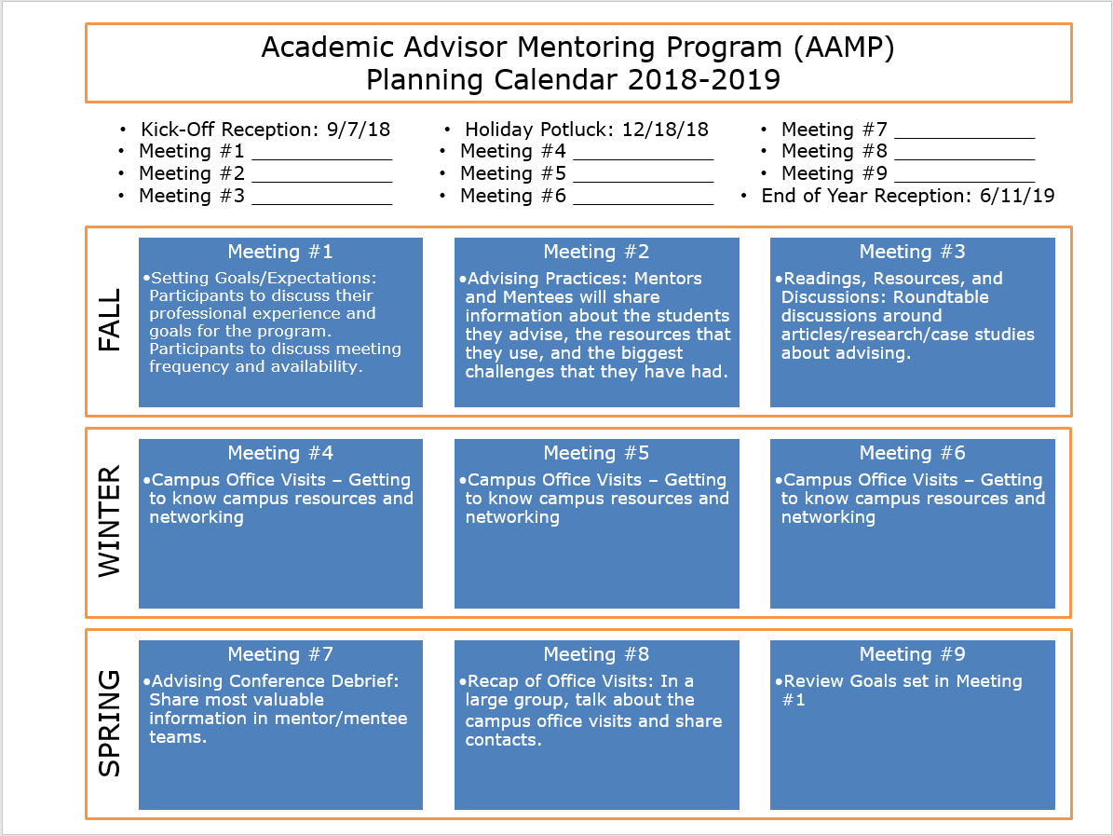
Notes:
Nancy

Slide 17
Calendar of Events
ACADEMIC YEAR OVERVIEW
FALL QUARTER
WINTER QUARTER
SPRING QUARTER
Lunch & Learn(How to present at a conference), SWEET & SAVORY SWAP
Lunch & Learn(Student Resource Panel), POTLUCK
Lunch & Learn(Professional Development), END OF YEAR CELEBRATION
Notes:
NANCY

Slide 18
The AAMP Website
ACADEMICADVISING.UCDAVIS.EDU/MENTORING
More information on the program and events calendar.
Notes:
RACHEL

Slide 19
ADVISOR CERTIFICATE SERIES
OTHER PROFESSIONAL DEVELOPMENT OPPORTUNIES
NACADA REGION 9
UCAAC 2020
Notes:
Rachel D.

Slide 20
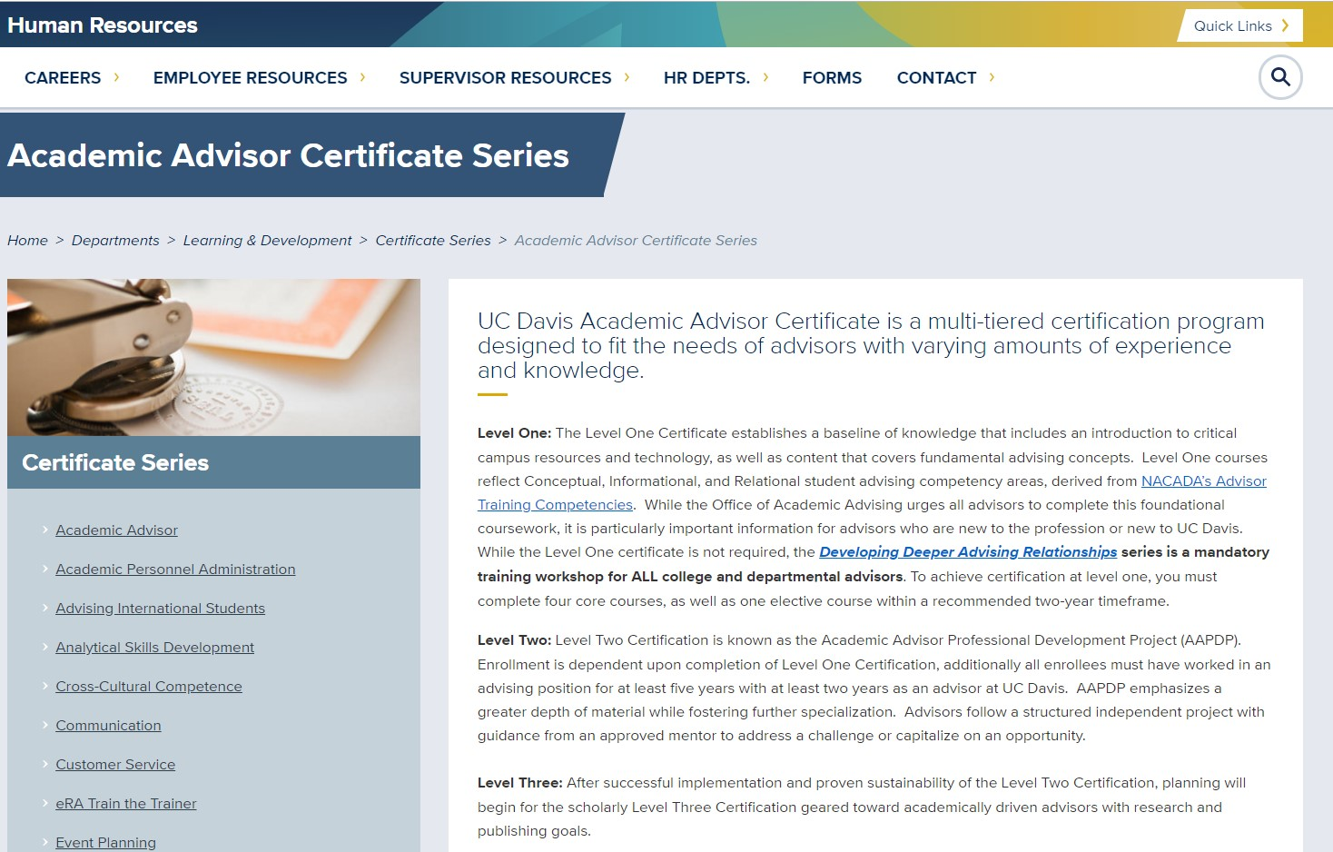
Notes:
Rachel D.

Slide 21
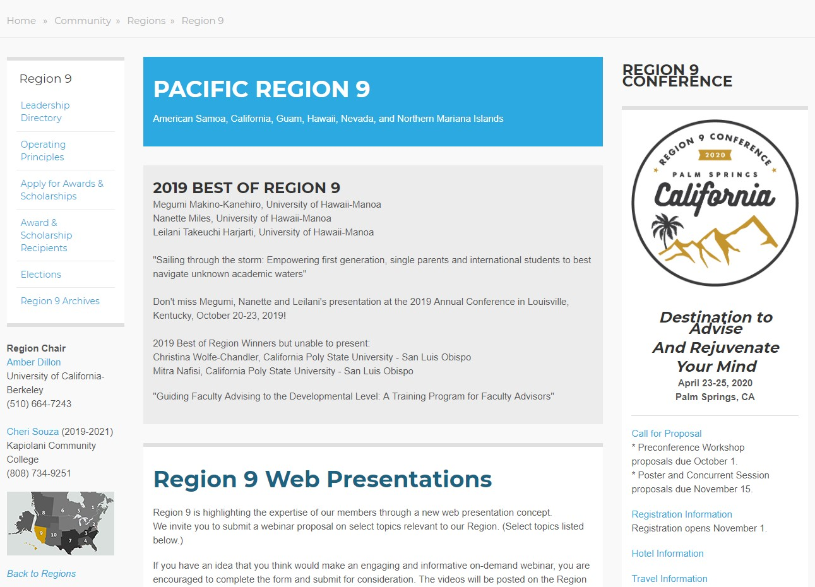
Website: NACADA.KSU.EDU
Notes:
Rachel D.

Slide 22
UC Academic Advising Conference
Notes:
Rachel D.

Slide 23
QUESTIONS?

