Slide 1
Remote Advising in Unprecedented Times Wednesday, September 9, 2020

Slide 2
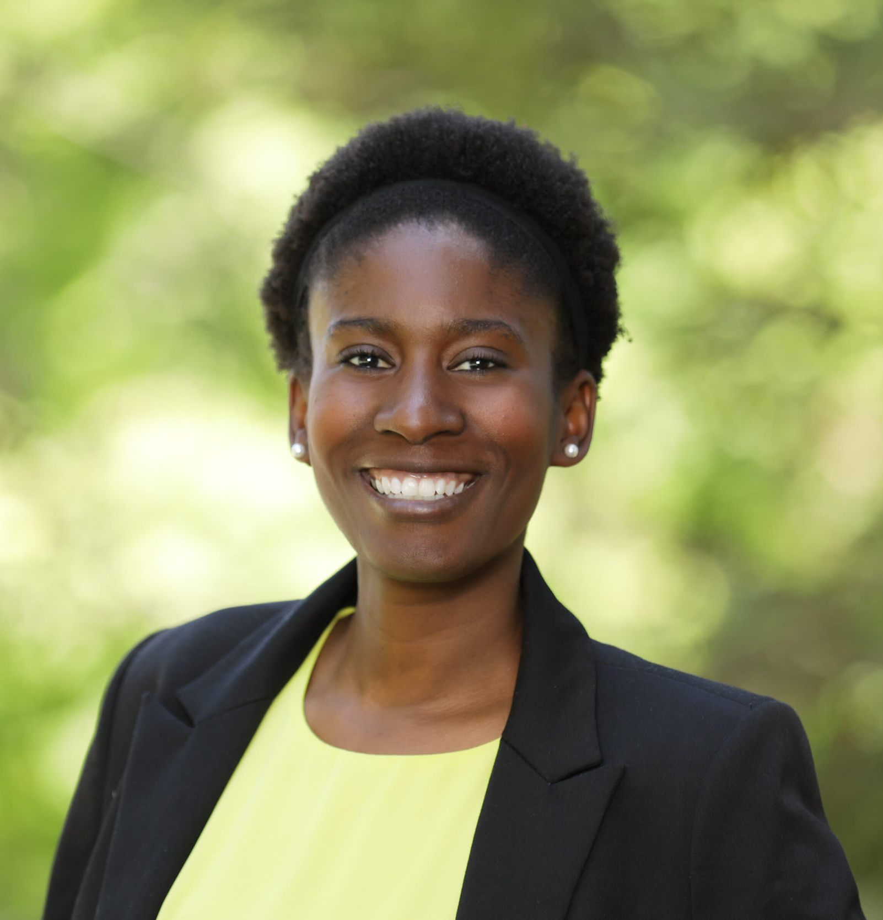
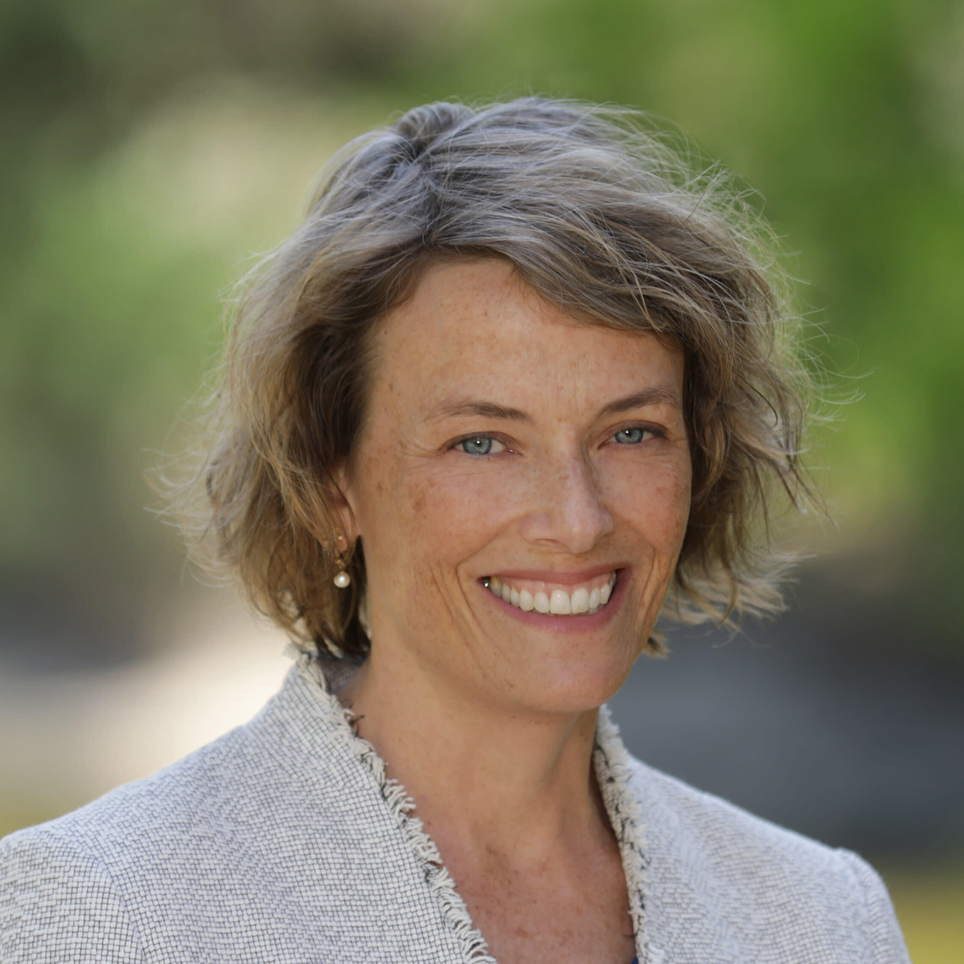
Ideas for Remote Advising
• Emphasize Communication
• Seek Flexibility in Academic Progress
• Support Students in Distress
Slande Erole
Ph.D. Student
Political Science
GSADC
Ellen Hartigan-O’Connor
Associate Dean of Graduate Students and Postdoctoral Scholars

Slide 3
Emphasize Communication
Learn where students are—geographically, academically, emotionally
Make contact first, rather than waiting for students to bring concerns to you
Establish expectations for communication—hours of availability, time zones, frequency
Try new modes of communication—Slack, 15-minute check-in meetings
Notes:
Think about how to adapt your project into something that is feasible given the current situation, or consider an entirely new project if you are not too far along.
This is a good opportunity to learn a different aspect of your field, e.g.,
1. simulation, 2. meta-analysis of other existing datasets, 3. how to measure what you want in a new way, 4. understanding proxy data that is close to what you want. See this as an opportunity to broaden your skill set and having that breadth may help you in the future. If your thesis is of the form 3 papers, make a start on one of the remaining papers, e.g., do the literature review, thing through the details of the “experiment”/case study and anticipate what problems might arise, in other words, take more time than you normally would to get it right so that when you do get to do it, you will have anticipated the problems.
Having those helpful casual conversations in the office with other students, professors, coordinators. How do you make up for those? Being more intentional about having them.
You may feel like you’re not making enough progress. It is common at the best of times (impostor syndrome). But it can be worse in these times. Check in with other students and try to see how they are doing - does everyone feel the same way? Talk to your major professor and see if she feels the same way. Maybe their productivity has diminished also. If not, talk to your peers and your MP to figure out what works well for them. You have a different situation, so adapt the suggestions to your case. If your MP feels you’re not making progress, talk to them about what their expectations are and how you can meet them, or meet in the middle!

Slide 4
Questions & Answers
Please post questions using the Q&A feature in Zoom.

Slide 5
Seek Flexibility in Academic Progress
Acknowledge and work with individual circumstances
Establish and celebrate smaller, short-term milestones
Brainstorm alternative ways forward, such as adjusting research focus, switching the sequence of intermediate steps, or identifying different modalities
Consider exceptions when it makes sense, but help students think through consequences

Slide 6
Questions & Answers
Please post questions using the Q&A feature in Zoom.

Slide 7
Support Students in Distress
Remember that you may be the only person in the program a student is talking to
Help students combat isolation by encouraging or organizing remote group activities
Volunteer information about Student Health and Counseling Services, Basic Needs Center, Childcare Grants
Prepare resources in advance when delivering bad news remotely

Slide 8
Questions & Answers
Please post questions using the Q&A feature in Zoom.

Slide 9
grad.ucdavis.edu/covid-faq

